Slide 1
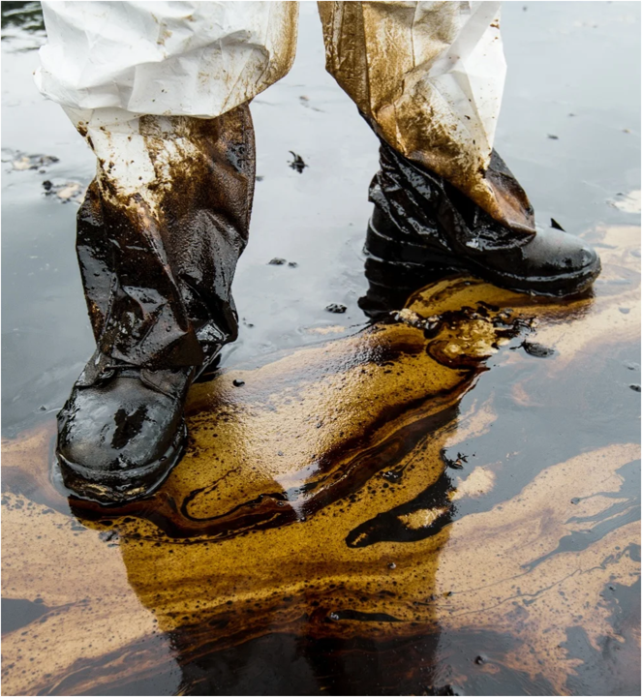
Health and Safety during a Response
Notes:
Welcome to the Health and Safety module. Emphasise that no operational objective is more important than protecting responders, the public, and the environment. Explain that effective safety management must be integrated into every phase of an oil spill response from mobilisation through demobilisation.

Slide 2
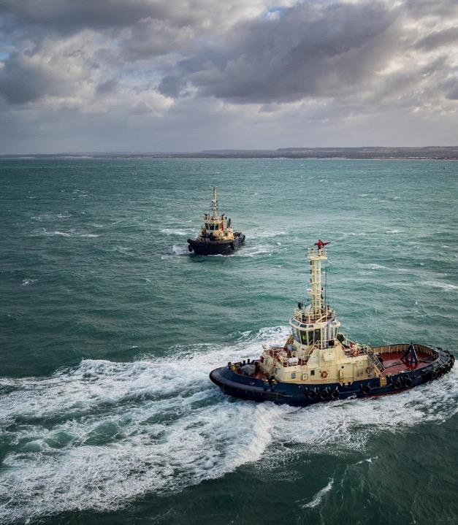

Health and Safety during a Response
Objectives
1
Recognise the potential hazards on a spill
2
Understand the key elements of a safety plan
3
Understand the health and safety aspects of oil spill response Identify areas of risk
Notes:
Discuss the learning objectives. Participants should be able to identify common response hazards, recognise symptoms of toxic exposure, understand the purpose of safety plans and risk assessments, identify high risk activities, and select appropriate control measures. Reinforce that risk management is a continuous process throughout the response.

Slide 3
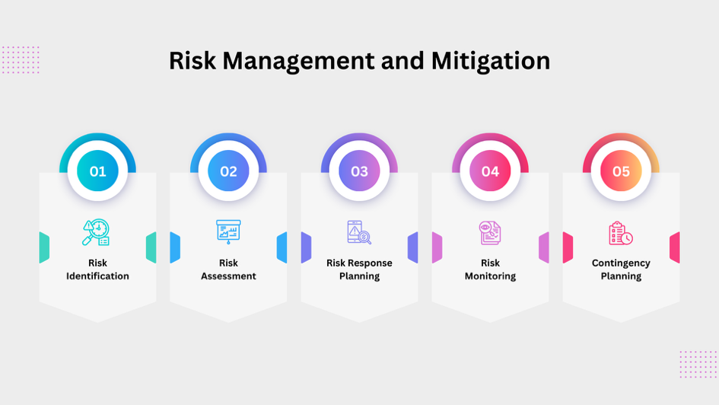
Notes:
Use this slide as an opening discussion. Ask participants to share examples of incidents or near misses they have experienced during spill response, marine operations, or industrial activities. Highlight lessons learned and stress the value of reporting hazards before incidents occur.

Slide 4
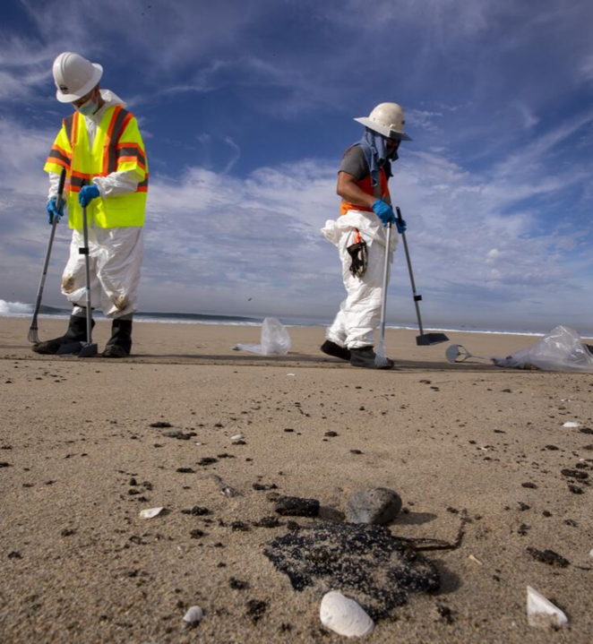
Why do we care about safety?
What safety documents do we use?
Notes:
Ask the group why safety must be a priority during response operations. Guide discussion towards legal responsibilities, duty of care, protection of personnel, prevention of secondary incidents, reputation management, and operational effectiveness. Introduce the key safety documents used during a response including safety plans, risk assessments, JSAs, toolbox talks and emergency response procedures.

Slide 5
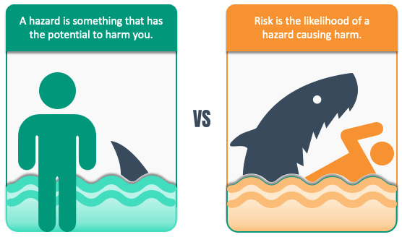
Identify the Hazards
Scenario 1
Shoreline Cleanup Scenario:
Scenario:
Workers are deployed to clean up a stretch of beach after an oil spill has contaminated the shore, using manual tools and absorbent materials.
Scenario 2
Offshore Cleanup Scenario:
Crews are working on boats and using skimmers and booms to contain and recover oil from the sea surface after a spill.
Notes:
Divide participants into groups and assign the shoreline and offshore scenarios. Ask them to identify hazards, the associated risks, and possible mitigation measures. Encourage consideration of slips, trips and falls, manual handling, vessel operations, weather, fatigue, contamination, wildlife interactions, tides, machinery and vehicle movements. Capture answers for discussion.

Slide 6
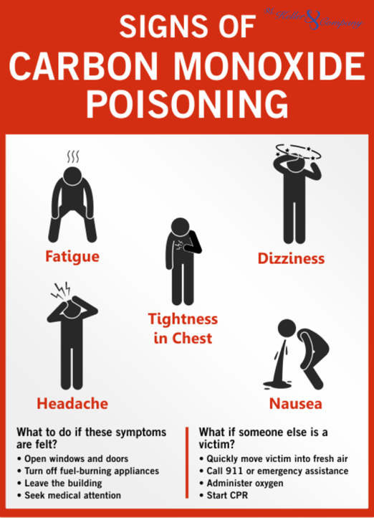
Toxic Exposure Symptoms
What are the symptoms for Heavy fuel oil? – change for clients most likely product
What are the preventative measures?
Notes:
Explain that exposure symptoms vary depending on the oil type and environmental conditions. Discuss common symptoms including headaches, dizziness, nausea, eye irritation, skin irritation and respiratory discomfort. Review preventive measures such as monitoring exposure, maintaining hygiene, limiting exposure duration, ensuring ventilation and wearing suitable PPE. Remind participants to report symptoms immediately.

Slide 7
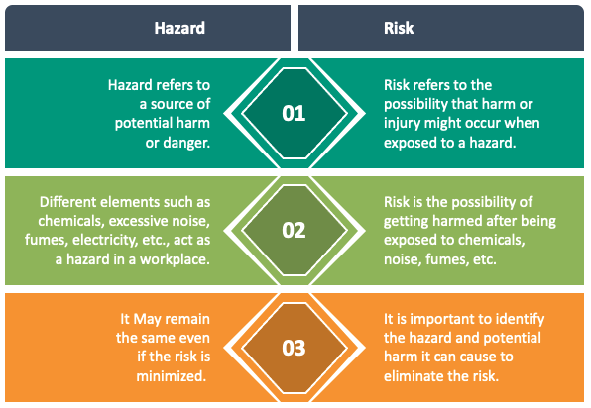
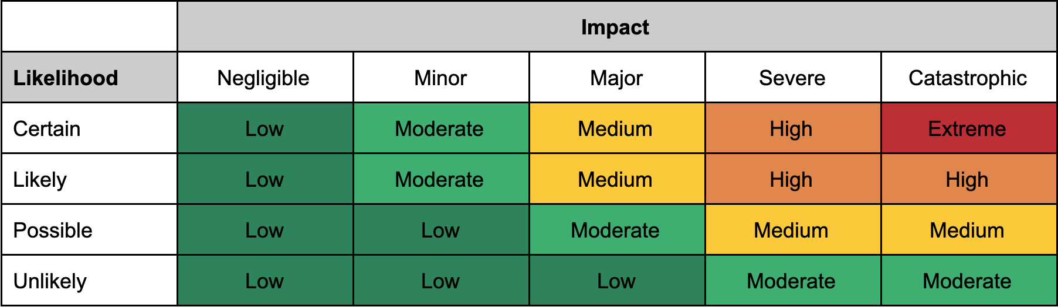
Notes:
Review the images and ask participants to identify visible hazards. Use the examples to discuss hazard recognition as a core competency. Highlight how responders must continually scan their work area for changing conditions and emerging risks.

Slide 8
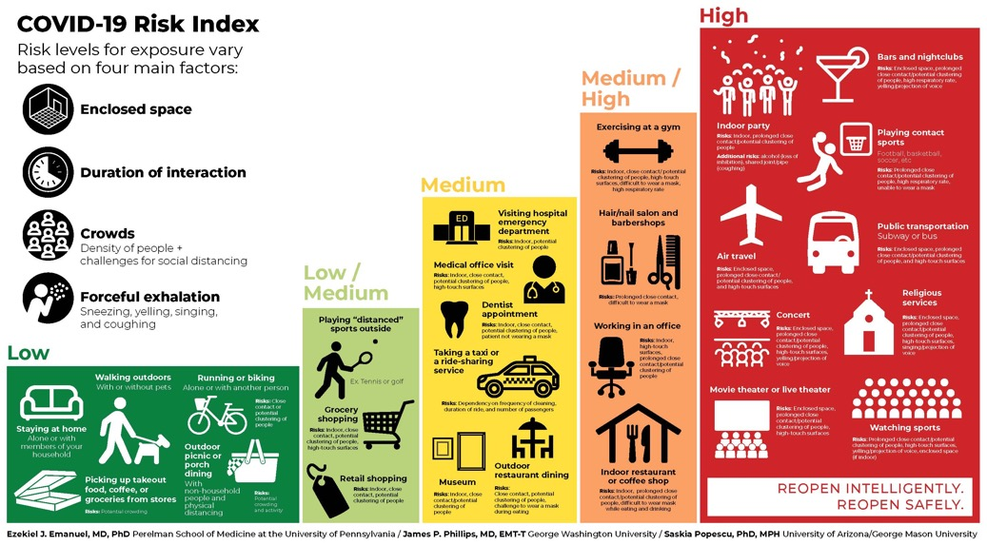

Notes:
Discuss PPE selection and safe working practices. Explain that PPE is the last line of defence and should be used alongside engineering and administrative controls. Reinforce the importance of correct fit, maintenance, inspection and replacement of PPE.

Slide 9
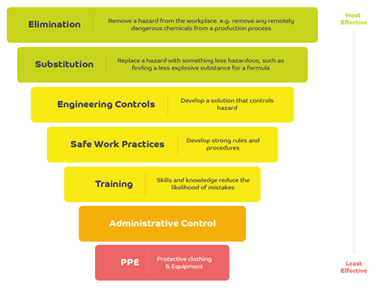
Notes:
Use this slide to discuss dynamic risk assessment. Conditions during a spill response can change rapidly due to weather, tides, operational tempo, equipment failures or changes in oil behaviour. Encourage personnel to stop work whenever conditions become unsafe and reassess the task.

Slide 10
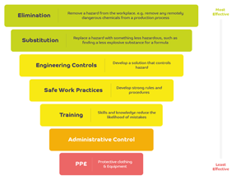
Identify the Hazards
Scenario 1
Shoreline Cleanup Scenario:
Scenario:
Workers are deployed to clean up a stretch of beach after an oil spill has contaminated the shore, using manual tools and absorbent materials.
Hazard | Risk | Mitigations
Scenario 2
Offshore Cleanup Scenario:
Crews are working on boats and using skimmers and booms to contain and recover oil from the sea surface after a spill.
Notes:
Facilitate completion of the hazard, risk and mitigation table. Encourage participants to think through the hierarchy of controls, beginning with elimination and substitution where possible before relying on PPE. Compare shoreline and offshore hazards and discuss how controls differ between environments.

Slide 11
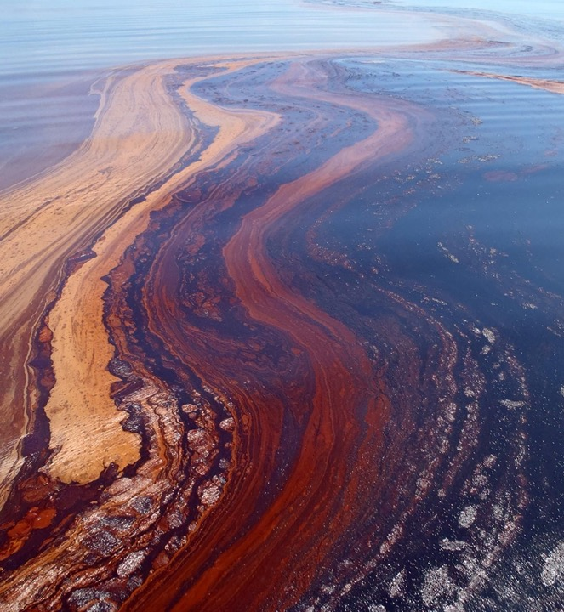
What Safety documents do we have during operations?
How often should these be updated?
Notes:
Review the key safety documents used during operations. Explain the purpose of each document and how they work together. Safety Plans define the overall approach, Risk Assessments identify hazards, JSAs analyse task-specific risks, IAPs communicate operational objectives, Toolbox Talks reinforce daily safety messages, and Emergency Response Plans provide incident procedures. Emphasise the need for regular review and updates throughout the response, particularly when conditions, personnel, equipment or operational objectives change.

